Slide 1

CSE- 410
Software Development
Lab: 01
Fahad Ahmed
Lecturer, Dept. of CSE
E-mail: fahadahmed@uap-bd.edu

Slide 2
Course Synopsis
Students have to develop on real life oriented projects that means solve a complex engineering problem in this course. Web technologies (ASP. Net, PHP, Ajax, Java Script, Joomla, and so on) and Database (DB2, Oracle, SQL Server, MySQL, and so on) are preferred for the development. Open Source projects are also preferred as Open source code is typically created through a collaborative effort in which programmers improve upon the code and share the changes within the community. Moreover, documentation is a major concern for the project to ensure the Software Quality Assurance (SQA). Hence at the end of semester students submit their projects including the documentation.

Slide 3
Project Groups
Project group
maximum 3 members**

Slide 4
Assessment
Assessment Type | % weight
Project Evaluation (Assessment) | 70%
Continuous Evaluation in Lab | 30%
Presentation | 20%
Viva | 20%
Report (Doc + Video) and CEP Mapping | 30%
Total | 100%

Slide 5
CO-PO
CO No. | CO Statements: Upon successful completion of the course, students should be able to: | Corresponding POs
CO1 | Identify, formulate, and analyze a real world problem based on requirement analysis. | 2-Problem Analysis
CO2 | Design/Develop a working solution on a real world problem using s/w designing tools. | 3-Design/ development of solutions
CO3 | Use modern development tools which are popular among s/w developers. | 5-Modern Tool Usage
CO4 | Identify societal, health, safety, legal and cultural issues related to the project. | 6-The Engineer and Society
CO5 | Practice professional ethics and responsibilities and norms of engineering practice. | 8-Ethics

Slide 6
CO-PO
CO No. | CO Statements: Upon successful completion of the course, students should be able to: | Corresponding POs
CO6 | Work as a team and fulfil individual responsibility. | 9-Individual and Team work
CO7 | Communicate effectively through presentation and write effective reports and documentations on the project. | 10-Communication
CO8 | Apply project management principles using Version Control System, and produce cost value analysis. | 11-Project Management and Finance
CO9 | Recognize the need for, and have the preparation and ability to engage in independent and life-long learning in the broadest context of requirement changes and introduction of modern development tools | 12-Lifelong learning
CO10 | Apply the S/W Engineering knowledge to provide a working solution on a real world problem | 1-Engineering Knowledge

Slide 7
Weighting COs with Assessment methods
Assessment Type | % weight | CO1 | CO2 | CO3 | CO4 | CO5 | CO6 | CO7 | CO8 | CO9 | CO10
Presentation | 20% | 10 |  |  | 5 |  |  | 5
Report and CEP Mapping | 30% | 5 | 5 |  | 3 | 5 |  | 2 | 5 | 5
Viva | 20% |  |  |  | 2 | 5 | 5 | 3 |  | 5
Continuous Project Evaluation (Assessment) | 30% |  | 10 | 5 |  |  | 5 |  | 5 |  | 5
Total | 100% | 15 | 15 | 5 | 10 | 10 | 10 | 10 | 10 | 10 | 5

Slide 8
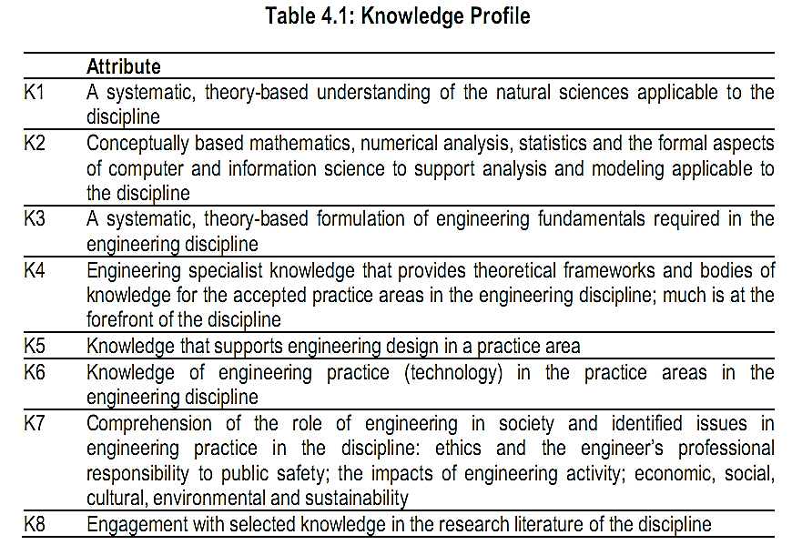
Complex Engineering Problems

Slide 9
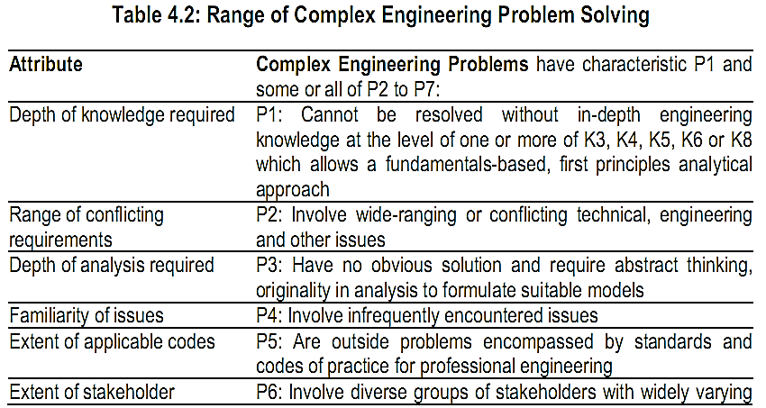
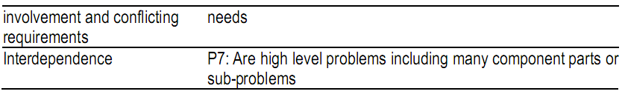
Complex Engineering Problems

Slide 10
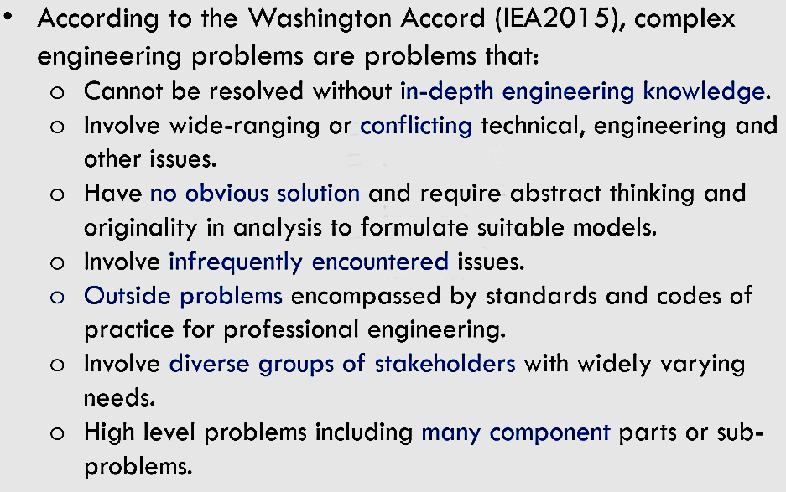
Complex Engineering Problems
How to Demonstrate through Projects?

Slide 11
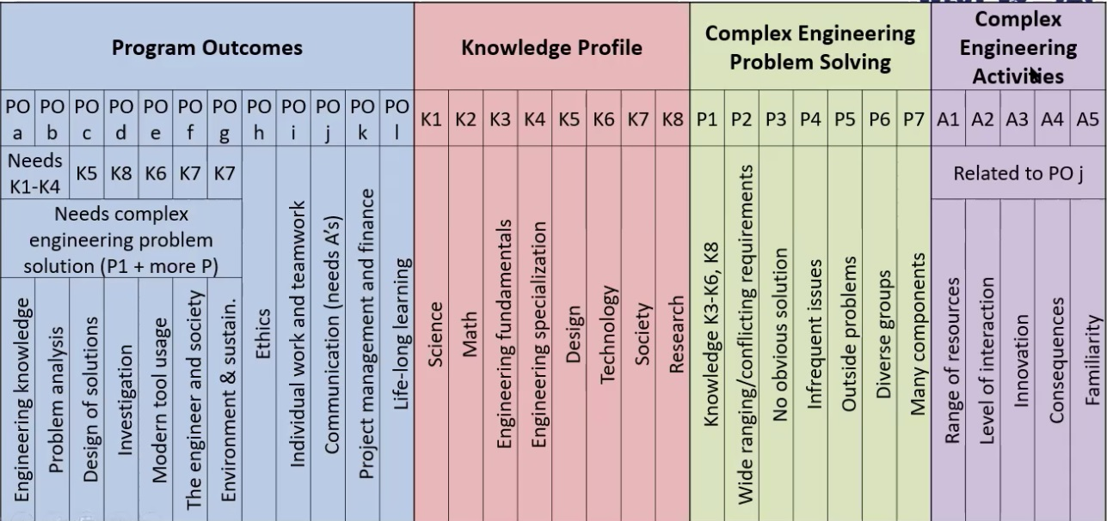
Complex Engineering Problems

Slide 12
Project Idea
This are not complex engineering problem (CEP), try to make it into CEP
https://nevonprojects.com/year-projects-for-computer-engineering/
https://1000projects.org/

Slide 13
Consultancy
Contract Number: 01737777912 (9 am- 8 pm)
Email: fahadahmed@uap-bd.edu

Slide 14

Thanks to All

